Slide 1


EXL – LOGIC EQ
Presentation
Team Name – Data Devourers

Slide 2
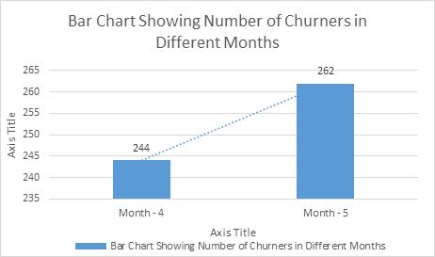
As per the provided problem, we have observed that some of the customers have started leaving the service ABC Corporation. We need to build a statistical or machine learning model to predict which customers are more likely to be among Churners, so that we can concentrate more on those customers.
Understanding of Business Problem

Slide 3
Data Treatment
Modelling/ Validation Dataset
1. Commence Date -> Loyal Years
2. Payment Sum -> Payment in last 3 months
3. Call Center Statements -> Boolean Features { Operation, Utility, Payment, Account} etc.
Feature Extraction
Feature Selection
Changing Nominal Features to New Boolean Features.
Subtracting Mean and Dividing by Std Deviation.
Imputation
Replacing Missing Values by Medians
Normalization

Slide 4
Modeling
START
Validation
Modelling Dataset
Raw Dataset
Validation Dataset
Hold Out Dataset
Training Dataset
Data Processing
Data Processing
Data Processing
Output
Model - SVM/ KNN/ Neural Nets/ Logistic Regression
Test model
K – Cross Validation to obtain the best model
END
Best Model Obtained
Methodology
Result

Slide 5
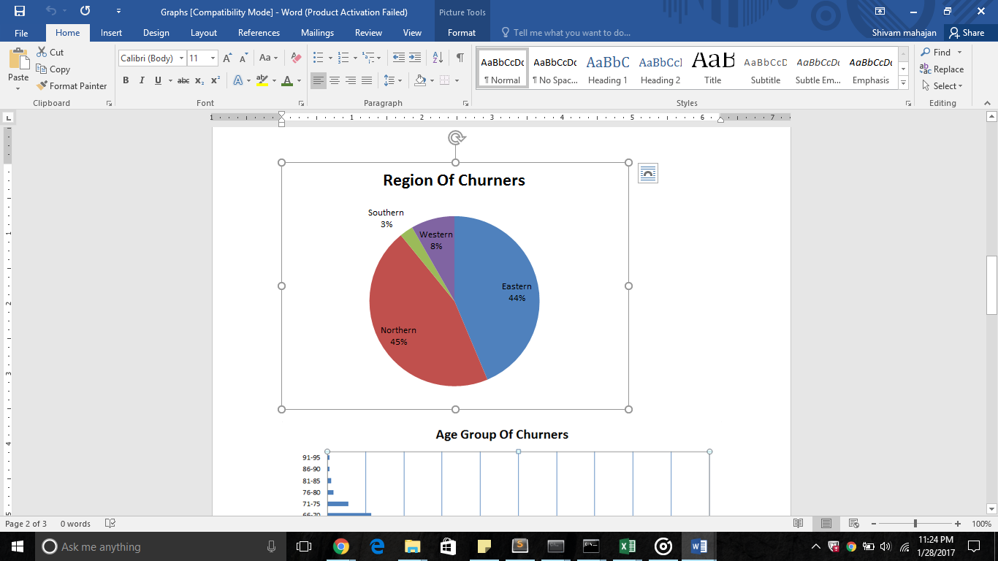
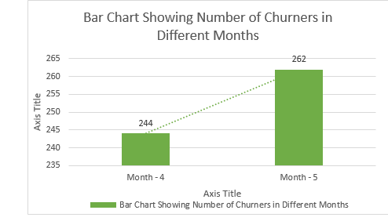
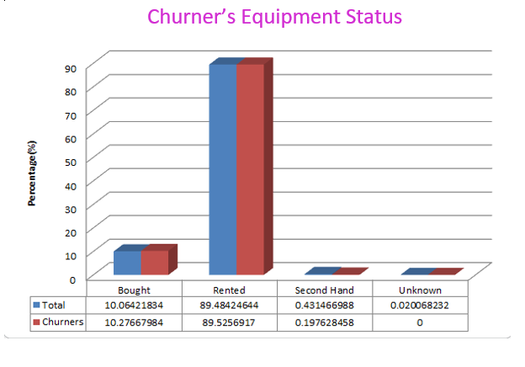
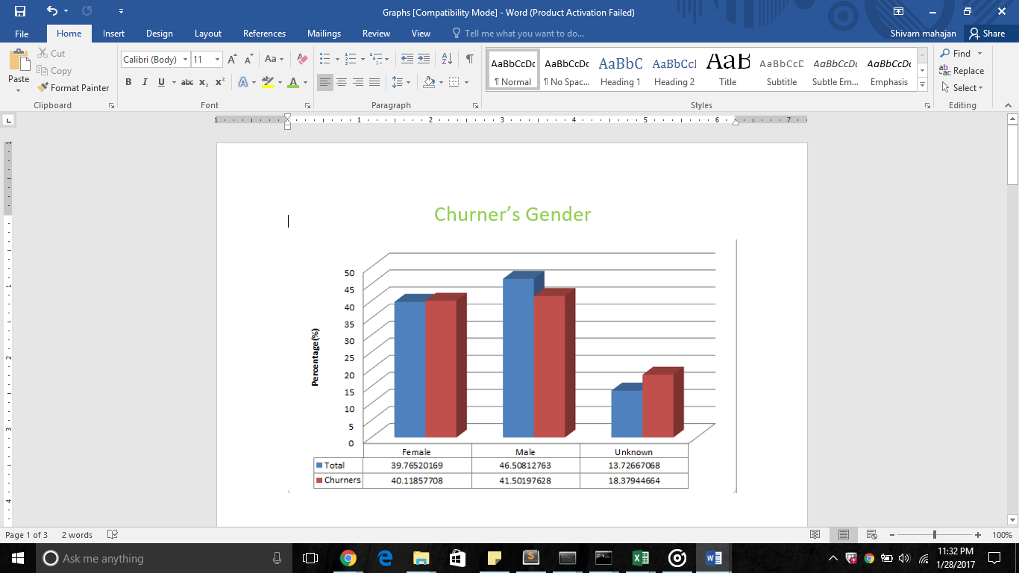
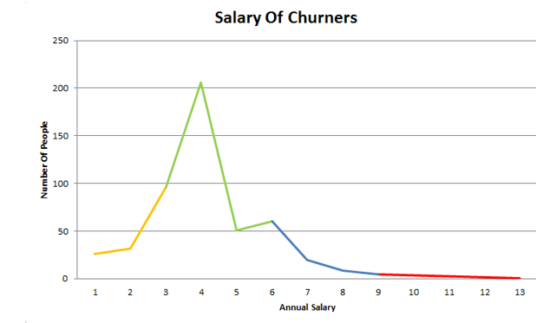
Visual Output

Slide 6
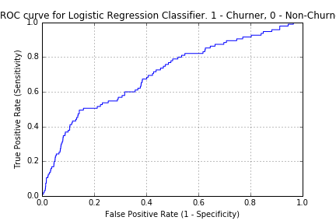
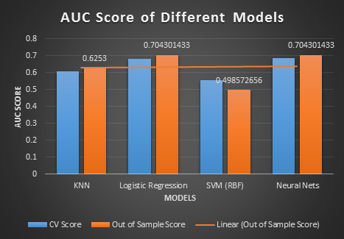
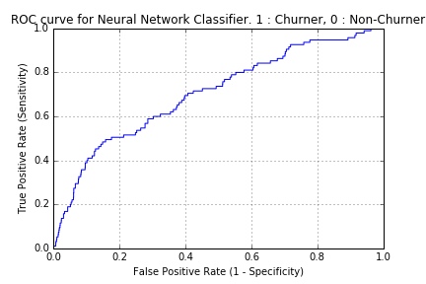
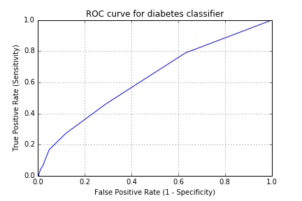
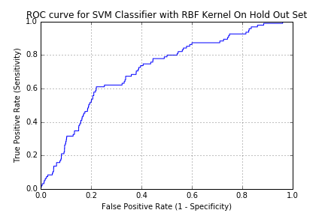
Visual Output
Different Models Accuracy

